Slide 1


Inaugural PSL-Africa
User Group Meeting
Objectives
of the Meeting
Gaborone 9th – 11th February 2004

Slide 2
Create a “Family”
Share experiences between users for mutual benefit
Posts to understand better, what is available through the Integrated Postal Architecture – and when
PSL to gain user input to our development roadmap
PSL to understand the business and automation strategy of the Posts
Potential to better plan cost sharing for new developments
Assist Posts to prepare individual automation roadmaps as part of their business strategy

Slide 3
Ensure Maximum Benefit from Automation
Structure the project the get the most from the investment in automation
How to improve the profitability of the Post
Revue the roles of the different disciplines in a Post, i.e. marketing, operations, IT, finance, etc.
Ensure that the management of the Post understand what automation can do for them

Slide 4
Automation Roadmap
Every business should know where they are going
There will be a Business Strategy agreed by the Board
An Operational Automation Strategy will support the Business Strategy
An IT Strategy will support the Automation Strategy
Add planned timescales and you achieve a Roadmap for the business

Slide 5
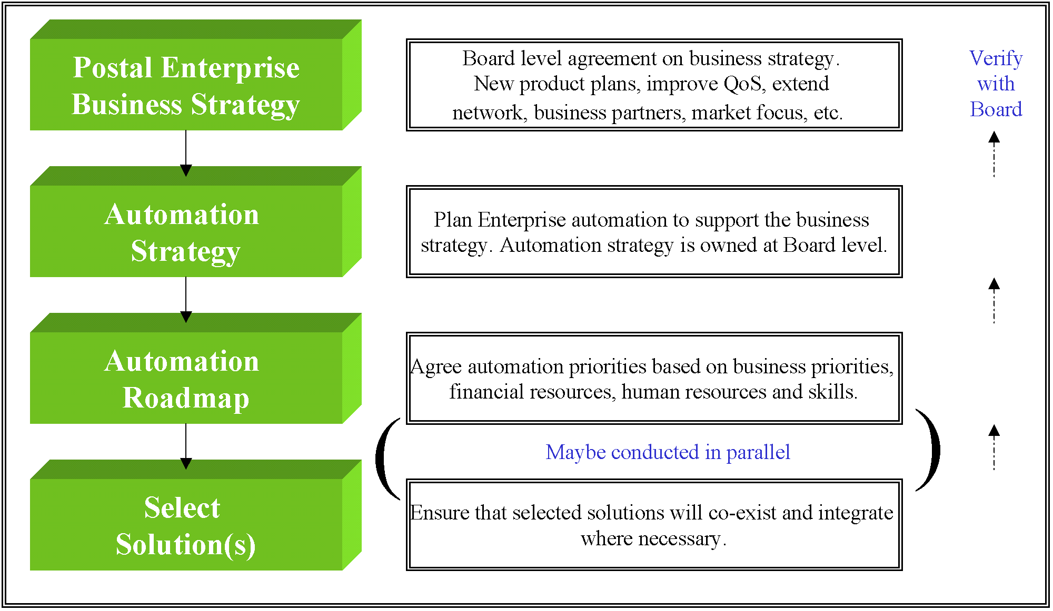
Automation Roadmap

Slide 6
Automation Roadmap
Should be mapped against the business strategy of the Post and agreed by management
Year 1
Year 2
Year 3
Year 4
Year 5
R O A D M A P
Project Plan – 2 Years
Approximately

Slide 7
Current Projects
BotswanaPost
  Corvus, Consolidate, Shirika, Indigo3, Osmium
Ghana Post
  Corvus, Consolidate, Shirika
SwaziPost
  Corvus, Consolidate, Shirika, Indigo3
Tanzania Post
  Corvus, Consolidate, Shirika, Indigo3, Inventory
Posta Uganda
  Corvus, Indigo3

Slide 8
Project Structure
The Board
Management Owner
Responsible for strategic decisions relating to the project and interface to the board. Part time.
Responsible for the day-to day management of the project, ensuring adherence to the project plan, managing the Working Group and providing progress reports to the Management Owner. Full time.
Project Manager
Working Group
Operations - ICT - Finance
Responsible for defining the requirements, system testing, training, system acceptance, hardware and network management, pilot support, roll-out support, etc.Some full time, some part time.
The Business

Slide 9

Postal Solutions Limited
Precision Postal Software Design
Notes:
Good Morning

